Slide 1
FINANCIAL STATEMENT ANALYSIS
Topic 2: Accrual accounting
Presented by:
Dr. Judy Taylor
Lecturer
School of Economics and Finance

Slide 2
Student learning objectives
2.1 Describe the criteria for revenue and expense recognition and discuss major issues in revenue and expense recognition including the affect on reported earnings and their implications for financial analysis;
2.2 Compare the percentage-of-completion method with the completed contract method and contrast the effects of the two methods on the income statement, balance sheet, statement of cash flows and selected financial ratios;
2.3 Describe the types and analysis of unusual or infrequent items, extraordinary items, discontinued operations, accounting changes, and prior period adjustments;

Slide 3
Student learning objectives
2.4 Discuss managerial discretion in areas such as classification of good news/bad news, income smoothing, big bath behavior, and accounting changes, and explain how this discretion can affect the financial statements;

Slide 4
References
White, G. I., A. C. Sondhi and D. Fried. (2003). The Analysis and Use of Financial Statements. (3rd edition). Wiley. Chapter 2.

Slide 5
Objective 2.1
Revenue and expense recognition
Revenue, measured as the amount expected to be collected, can be recognised when goods or services have been provided and their costs can be reliably be determined
SFAC 5 specifies two conditions that must be met for revenue recognition to take place:
  Completion of the earnings process: the firm must have provided all or virtually all the goods or services for which it is to be paid and it must be possible to measure the total expected cost of providing the goods or services
  Assurance of payment: the firm must be able to reasonably estimate the probability of payment

Slide 6
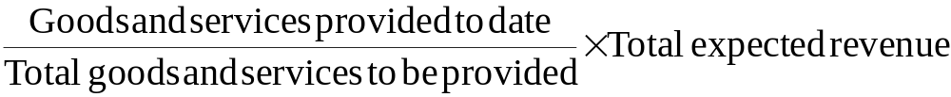
Objective 2.1
Revenue and expense recognition
The cumulative amount of revenue recognised at any given point in time is measured as:
Revenue reported for the current period, is equal to the cumulative total less revenue recognised in prior periods

Slide 7
Objective 2.1
Revenue and expense recognition
Differing methods of revenue recognition
  Sales basis method
  Percentage-of-completion method
  Completed contract method
  Installment method
  Cost recovery method

Slide 8
Objective 2.1
Sales based method
This is the most common method by which firms generate revenue
Goods or services are provided when the sale is made
The sale is settled in cash or credit to a customer with a high probability of repayment
Revenue is recognised at the time of sale
Exceptions are where the cash is received prior to the goods or services being provided
  Magazine subscriptions not recognized until delivery
  Credit card fees not recognized until the passage of time
  Equipment leases not recognised until equipment is used

Slide 9

Example 2.1.1
Sales based method
A retailer sells $100 million worth of goods in the period, paid cash-on-delivery, with delivery occurring on a same day basis. The cost of goods sold plus selling and administrative costs for the period are $80 million.
What is the revenue reported for the period?

Slide 10

Example 2.1.1
Sales based method
The revenue reported according to the sales based method would be $100 million, as full payment for the goods has been received during the period and the costs are known.

Slide 11
Objective 2.1
Percentage-of-completion method
This is most common with long-term contractual projects, which have reliable estimates of production completed, revenues and costs
Revenue is recognised in proportion to and as the work is completed
Progress towards completion is measured by:
  Engineering estimates or tangible milestones
  Ratios of costs incurred to expected total cost
Exceptions exist when conditions required for the percentage-of-completion method do not exist, in which case revenues and expenses are only recognised at the completion of the contract
  No contract
  Unreliable estimates
  All short-term contracts
Notes:
This method may overstate revenue when the expenditures made are recognised before they contribute to completed work, e.g. when costs of raw materials and advanced payments to sub-contractors are included in the determination of work

Slide 12
Example 2.1.2
Percentage-of-completion method
In 2001, Justin Corp. entered into a construction project with a total contract price of $6 million and expected costs to complete of $4.8 million resulting in expected profits of $1.2 million.
Actual costs and cash flows (‘000) | 2001 | 2002 | 2003
Cost incurred | $800 | $2,800 | $1,200
Cumulative costs incurred | 800 | 3,600 | 4,800
Estimated remaining costs | 4,000 | 1,200 | 0
Amounts billed and received | 1,300 | 2,500 | 2,200
Cumulative amounts billed and received | 1,300 | 3,800 | 6,000
Calculate revenue according to percentage-of-completion method.

Slide 13
Example 2.1.2
Percentage-of-completion method
The revenue recognised in 2001, 2002 and 2003, respectively, would be (in ‘000):

Slide 14
Objective 2.1
Completed contract method
This method is used for long-term projects where there is no contract, or where there are no reliable estimates of production completed, revenues and costs, or if the contract is a short-term contract
Revenue is recognised at the completion of the project

Slide 15
Example 2.1.3
Completed contract method
In 2001, Justin Corp. entered into a construction project with a total contract price of $6 million and expected costs to complete of $4.8 million resulting in expected profits of $1.2 million.
Actual costs and cash flows | 2001 | 2002 | 2003
Cost incurred | $800 | $2,800 | $1,200
Cumulative costs incurred | 800 | 3,600 | 4,800
Estimated remaining costs | 4,000 | 1,200 | 0
Amounts billed and received | 1,300 | 2,500 | 2,200
Cumulative amounts billed and received | 1,300 | 3,800 | 6,000
Calculate revenue according to completed contract method.

Slide 16
Example 2.1.3
Completed contract method
The revenue recognised would be zero in 2001 and 2002, prior to the completion of the contract and in 2003 when the contract is completed it would be $6,000,000 and the profit would be:

Slide 17
Objective 2.1
Instalment method
This method is used when there is no reasonable basis to estimate the collectibility of sales proceeds, but the costs of goods and services is known, e.g. in the case of the sale of some non-current assets and real estate transactions
Revenue and costs are recognised as and in proportion to cash collected
Notes:
This may result in a delay in the recognition of profit

Slide 18
Example 2.1.4
Instalment method
In 2004, Company A sold goods costing $15 million for $20 million. Payment for the goods was by instalment, with the company receiving $12 million in 2004, $5 million in 2005 and $3 million in 2006.
Calculate revenue according to instalment method.

Slide 19
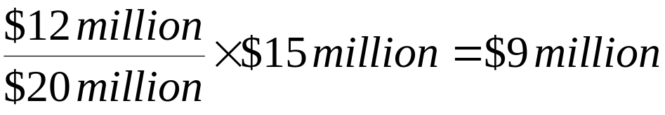
Example 2.1.4
Instalment method
Revenue is recognised as it is received, therefore the revenue reported in 2004, 2005 and 2006, respectively would be $12 million, $5 million and $3 million
Note that the costs would be apportioned according to the proportion of revenue received, hence in 2004, for example, the costs reported would equal:

Slide 20
Objective 2.1
Cost recovery method
This method is used when the costs to provide the goods or services cannot reasonably be determined, e.g. in the case of the development of land into suburban blocks with full services, which require the construction of roads and services and may be dependent on rezoning and environmental factors such as hazardous waste removal
Revenue and costs are recognised only after all costs incurred are recovered

Slide 21
Example 2.1.5
Cost recovery method
In 2004, Company A sold goods costing $15 million for $20 million. Payment for the goods was by instalment, with the company receiving $12 million in 2004, $5 million in 2005 and $3 million in 2006.
Calculate revenue according to cost recovery method.

Slide 22
Example 2.1.5
Cost recovery method
No revenue would be recognised in 2004 as the revenue received is less than the total costs of the goods. In 2005, the cumulated revenue received is greater than the total cost of the goods for the first time and hence $17 million revenue is recognised, being the total revenue received to date. In 2006, $3 million in revenue is recognised as all costs have been recovered.
Note that total costs would be reported in 2005, being the year in which cumulative revenue exceeds total costs for the first time. In 2004, no costs would be recognised as no revenue is recognised. In 2006, no costs would be recognised as all costs were recognised in 2005.

Slide 23
Objective 2.1
Issues in revenue recognition
In comparing revenue growth across companies or periods or in valuing companies based on a revenue or gross profit multiple, analysts must be wary of methods companies may use to artificially inflate reported revenues, for instance:
  Recording barter-based revenues at list prices rather than the lower arm’s-length price
  Recording license fees on signing rather than over term of license
  Recording revenues based on estimated usage prior to invoicing
  Recording agency-based revenue as a gross amount rather than as the net commission income
  Recognition of all contractual revenue prior to customer’s sign-off on completion of contract

Slide 24
Objective 2.1
Issues in expense recognition
In comparing profit growth across companies or periods or in valuing companies based on profit multiples, analysts must be wary of methods companies may use to artificially deflate reported expenses, for instance:
  Deferring marketing costs and sales commissions which may temporarily increase reported profit
  Expensing or capitalising and amortising the cost of periodic major maintenance projects rather than accruing the costs in advance
  Underestimating the expense recognition required for bad debts when the provision for bad debts should reflect the proportion of credit customers likely to default
  Underestimating the expense recognition required for warranties when the full cost of warranties should be expensed at the time of sale
Notes:
Analysts can examine the effect of the deferral of expenses by deducting the increase in capitalised expenses from reported profit (see Sears: White page 47)
For an example of not expensing periodic maintenance (see Airborne Freight: White 47)
Analysts can examine the effect of under-providing for bad debts by examining the ratio of bad debt provision to receivables and by examining the growth in receivables relative to the growth in bad debt provisions (see Lucent: White 48)
Analysts can examine the effect of under-providing for warranties by examining the ratio of warranty expensed to sales (see AT Cross: White 49

Slide 25
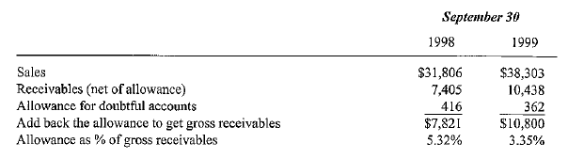
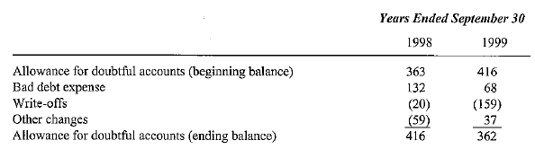
Example 2.1.6
Provisioning for bad debts: Lucent
Analyse Lucent’s bad debt provisioning.
Notes:
See White 48

Slide 26
Example 2.1.6
Provisioning for bad debts: Lucent
Red Flags:
  Allowance as a percentage of gross receivables has fallen in 1999
  In 1999, gross receivables is up 38%, sales is only up 20%
Timing of expense for bad debts and actual write-off do not coincide
  In 1998, bad debts expensed were $132m, whereas only $20m was actually written off, as uncollectible, via a charge against reserves
  In 1999, bad debts expensed was lower at $68m than actual write-off at $159m
Lucent reduced its allowance for bad debts provision in 1999
Had Lucent maintained its allowance for bad debs provision at the same proportion of gross receivables as 1998 (416 / 7821 = 5.32%) it would reduce pretax income by (10800 x 0.0532) – 362 = 213m
Notes:
See White 48

Slide 27
Objective 2.1
Issues in classification of costs
In comparing gross profit or gross margin across companies or periods or in valuing companies based on gross profit multiples, analysts must be wary of methods companies may use to artificially inflate reported gross profit, for instance:
  Recording costs such as discounts and marketing costs as selling and administrative expenses rather than as cost of goods sold
  Recording shipping and handling costs (included in revenue) as selling and administrative expenses rather than cost of goods sold

Slide 28
Objective 2.2
Pct-of-completion vs completed contract method
Different patterns of revenue, expense and income are reported, despite the fact that cash flow, total revenue, expense and income over the period of the contract are identical under both methods
Percentage-of-completion method reports revenue earlier and is a better indicator of trends in earning power
Percentage-of-completion method shows less volatile earnings as some is recognised each year
Percentage-of-completion method provides a better measure of operating activity and a more informative disclosure of the status of incomplete contracts

Slide 29
Objective 2.2
Pct-of-completion vs completed contract method
Different patterns of assets and liabilities are reported during the contract, despite the fact that assets and liabilities at the end of the contract are identical under both methods
Percentage-of-completion method reports larger assets during the period of the contract as a percentage of profit is realised
Percentage-of-completion method reports greater “construction in progress – inventory” account during the project
Percentage-of-completion method reports greater shareholder equity during the project
Percentage-of-completion method reports lower liabilities to equity and liabilities to assets ratios during the project

Slide 30
Example 2.2.1 (extends example 2.1.2)
Pct-of-completion vs completed contract
In 2001, Justin Corp. entered into a construction project with a total contract price of $6 million and expected costs to complete of $4.8 million resulting in expected profits of $1.2 million.
Actual costs and cash flows | 2001 | 2002 | 2003
Cost incurred | $800 | $2,800 | $1,200
Amounts billed and received | 1,300 | 2,500 | 2,200
Cumulative amounts billed and received | 1,300 | 3,800 | 6,000
Define income statement using percentage-of-completion method.

Slide 31
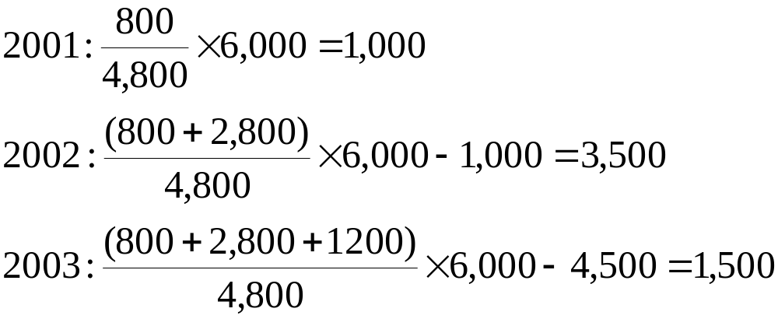
Example 2.2.1 (extends example 2.1.2)
Pct-of-completion vs completed contract
The revenues would be
Notes:
See White page 41, exhibit 2-1A

Slide 32

Example 2.2.1 (extends example 2.1.2)
Pct-of-completion vs completed contract
Enter contract data and cost and revenue data into the input section
Enter items that can be calculated, such as cumulative expense incurred and cumulative income accrued in prior periods
  Use the SUM function, e.g. Cumulative expenses in Cell F17 =SUM($D7:F7)
  The range of cells over which the data will be summed is defined by the array defined within the brackets following the function. An array is range of cells contained between and including the first and second cell reference included in the brackets and separated by a colon.
Enter the formulas to calculate net sales, COGS and gross profit
A total column can also be calculated using the SUM function

Slide 33
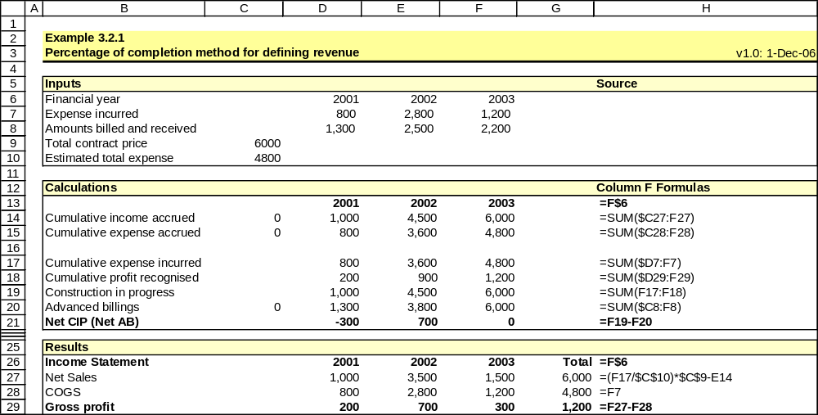
Example 2.2.1 (extends example 2.1.2)
Pct-of-completion vs completed contract
Notes:
See White page 41, exhibit 2-1A

Slide 34
Example 2.2.2 (extends example 2.1.3)
Pct-of-completion vs completed contract
In 2001, Justin Corp. entered into a construction project with a total contract price of $6 million and expected costs to complete of $4.8 million resulting in expected profits of $1.2 million.
Actual costs and cash flows | 2001 | 2002 | 2003
Cost incurred | $800 | $2,800 | $1,200
Amounts billed and received | 1,300 | 2,500 | 2,200
Cumulative amounts billed and received | 1,300 | 3,800 | 6,000
Define income statement using completed contract method.

Slide 35
Example 2.2.2 (extends example 2.1.3)
Pct-of-completion vs completed contract
Enter contract data and cost and revenue data into the input section
Enter items that can be calculated, such as cumulative expense incurred and cumulative income accrued in prior periods
Enter the formulas to calculate net sales, COGS and gross profit
  Use the IF function to enter a conditional statement, e.g. Net sales in Cell F27, which is conditional on cumulative income received being greater than the total estimated expenses is given by =IF(F20>$C10,F20-E14,0), where the first parameter in the bracket is the logical test, that cumulative income is greater than the total estimated expenses, the second is the result if the test fails and the third is the result if the test succeeds

Slide 36
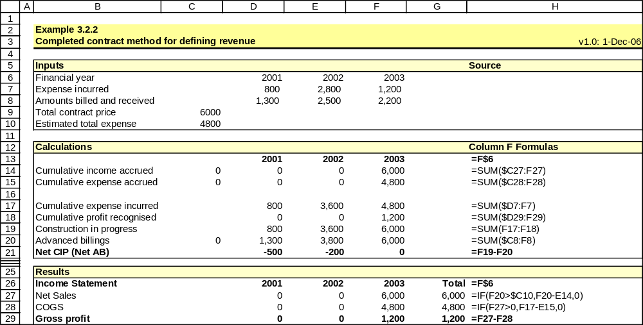
Example 2.2.2 (extends example 2.1.3)
Pct-of-completion vs completed contract
Notes:
See White page 41, exhibit 2-1A

Slide 37
Example 2.2.3 (extends example 2.1.2)
Pct-of-completion vs completed contract
In 2001, Justin Corp. entered into a construction project with a total contract price of $6 million and expected costs to complete of $4.8 million resulting in expected profits of $1.2 million.
Actual costs and cash flows | 2001 | 2002 | 2003
Cost incurred | $800 | $2,800 | $1,200
Amounts billed and received | 1,300 | 2,500 | 2,200
Cumulative amounts billed and received | 1,300 | 3,800 | 6,000
Define balance sheet using percentage-of-completion method.

Slide 38
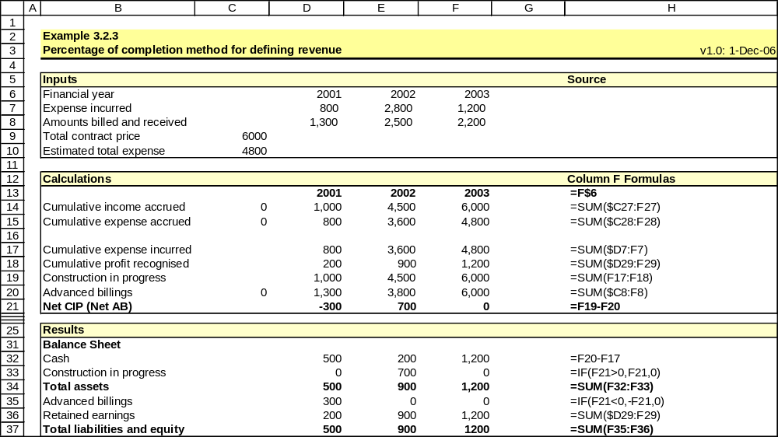
Example 2.2.3 (extends example 2.1.2)
Pct-of-completion vs completed contract
Notes:
See White page 41, exhibit 2-1B

Slide 39
Example 2.2.4 (extends example 2.1.3)
Pct-of-completion vs completed contract
In 2001, Justin Corp. entered into a construction project with a total contract price of $6 million and expected costs to complete of $4.8 million resulting in expected profits of $1.2 million.
Actual costs and cash flows | 2001 | 2002 | 2003
Cost incurred | $800 | $2,800 | $1,200
Amounts billed and received | 1,300 | 2,500 | 2,200
Cumulative amounts billed and received | 1,300 | 3,800 | 6,000
Define balance sheet using completed contract method.

Slide 40
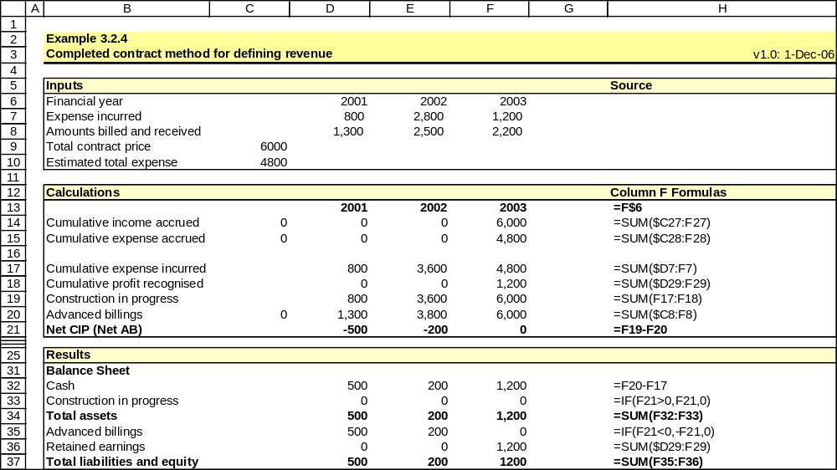
Example 2.2.4 (extends example 2.1.3)
Pct-of-completion vs completed contract
Notes:
See White page 41, exhibit 2-1B

Slide 41
Objective 2.3
Types of nonrecurring items
The income statement contains four categories of nonrecurring items:
  Unusual or infrequent items (pre-tax income from continuing operations)
  Extraordinary items (post-tax and not income from continuing operations)
  Discontinued operations (post-tax and not income from continuing operations)
  Accounting changes (post-tax and not income from continuing operations)
Analysts in determining the earnings amount used for valuation purposes, must examine the income statement to correctly identify recurring earnings from continuing operations
  Strip out non-core nonrecurring revenue and expenses
  Add back any items which though reported as nonrecurring are in the analyst’s opinion recurring

Slide 42
Objective 2.3
Unusual or infrequent items
Pre tax income from transactions or events, either unusual in nature OR infrequent in occurrence but NOT BOTH, may be disclosed separately as a component of income from continuing operations
Unusual or infrequent items may also be classified “other income” or buried in COGS or SG&A
Analyst may want to exclude these items from income forecasts
Examples of unusual or infrequent items include:
  Gain or loss from disposal of a portion of a business segment
  Gain or loss from sale of asset or investment in affiliate or subsidiary
  Provision for environmental remediation (e.g. environmental liabilities)
  Impairment, write-off, write-down, restructuring cost (e.g. reorganisation)
  Expense related to the integration of acquired company

Slide 43
Objective 2.3
Extraordinary items
Net income from transactions and events, that are unusual in nature AND infrequent in occurrence, which is material in amount, must be reported separately and excluded from net income from continuing operations
Examples of extraordinary items include:
  Loss due to a foreign government’s expropriation of assets
  Uninsured loss from natural disasters
  Gain or loss from the early retirement of debt were defined by SFAS 4 (1975) as extraordinary items, however SFAS 4 was repealed in 2002 and now such items are only extraordinary if meeting the above definition

Slide 44
Objective 2.3
Discontinued operations
Net income from discontinued operations and any net gains or losses from the sale/closure must be reported separately and excluded from net income from continuing operations
An operation is discontinued if it is sold, closed or held-for-sale
To qualify for treatment as a discontinued operation, its operations, assets and cash flows must be separable from the firm
Net income from discontinued operations is included for the period prior to being sold/closed, with adjustments made to prior income
Net gains or losses on the sale/closure are included in the period realised, except if the operation is held for sale when the estimated net losses are reported in the period in which it is held-for-sale

Slide 45
Objective 2.3
Accounting changes
Accounting changes are either undertaken voluntarily by the firm, or mandated by new accounting standards
Accounting changes are reported in the period of change
Any cumulative impact on current and prior period earnings is reported net of tax after extraordinary items and discontinued operations on the income statement, together with a detailed footnote
Other than in the case of the following exceptions, prior period earnings are not restated:
  Changes from LIFO to another inventory method
  Changes to or from the full cost method
  Changes to or from the percentage-of-completion method
  Changes in accounting methods prior to an initial public offering

Slide 46
Objective 2.3
Prior period adjustments
A change from an incorrect accounting method to an acceptable accounting method is treated as an error, and its impact is reported separately in the current period as a prior period adjustment net of tax and excluded from net income from continuing operations

Slide 47
Objective 2.3
Analysis of nonrecurring items
Items such as an asset write-down may suggest prior period depreciation and amortisation rates was insufficient
Items such as asset impairment or restructuring charges may suggest that future depreciation rates and other expenses will be accordingly lower, which will increase future net income
Some nonrecurring items such as restructuring charges regularly reoccur which may suggest they should be accounted for in forecasting future income
Some items have a once off effect on the firm’s value, such as those with no cash flow implications (write-downs) and those affecting the current period only (severance costs), other have ongoing effects on cash flow (lease payments for closed facilities)

Slide 48
Example 2.3.1
Analysis of nonrecurring items
Analyse the Pfizer Income Statement and Pfizer notes 5 to 8 for non-recurring items in 1998 and 1999

Slide 49
Objective 2.4
Management discretion and earnings manipulation
Items requiring separate disclosure on the income statement may be discretionary with respect to:
  Timing of the occurrence (disposal of an asset, asset writedown)
  Classification of the item (ordinary, unusual or extraordinary)
  Choice of accounting method or treatment (LIFO or FIFO)
Management practices which may distort net income as it is reported in the income statement include:
  Classification of good and bad news
  Income smoothing
  Big-bath behaviour
  Accounting changes

Slide 50
Objective 2.4
Classification of good and bad news
Management prefers to report good news “above the line” (i.e., as part of income from continuing operations) and bad news “below the line” (i.e., excluded from income from continuing operations) (see WSF, pp. 53 & 59). For instance, management is able to determine whether the component of a firm sold meets the definition of a discontinued operation and hence is able to be reported below the line.

Slide 51
Objective 2.4
Income smoothing
Management is able to reduce earnings in good years by deferring gains and recognising losses, and inflate earnings in bad years by recognising gains and deferring losses
Intertemporal smoothing techniques
  Timing expenditure such as R & D, repairs, maintenance and asset disposals
  Choosing accounting methods such as capitalisation or expensing that allocate expenses over time
Classificatory smoothing techniques
  Choosing to classify an item as either income from continuous operations or extraordinary income

Slide 52
Objective 2.4
Big-bath accounting
Contrary to income smoothing behavior, the big-bath accounting hypothesis suggests that management will report additional losses in bad years in the hope that by taking all available losses at one time they will clear the decks and increase future growth and profitability
Not supported in the academic literature, for instance Fried et al (1989) (see WSF p. 60) found that a firm taking an asset write-down in one year is likely to take another one soon after

Slide 53
Objective 2.4
Accounting changes
Most accounting changes have no direct cash flow effects, hence they may be used as a form of earning manipulation
Elliot and Philbrick (1990) (see WSF p. 61) examined the effect of accounting changes on earnings predictability and found, inter alia, that accounting changes that increased income were associated with downward forecast revisions, that is when income was lower than expected, forecasts would be revised down, possibly leading to accounting changes that raised income

Slide 54
Key Points

Slide 55
Excluded CFA learning objectives

